Slide 1
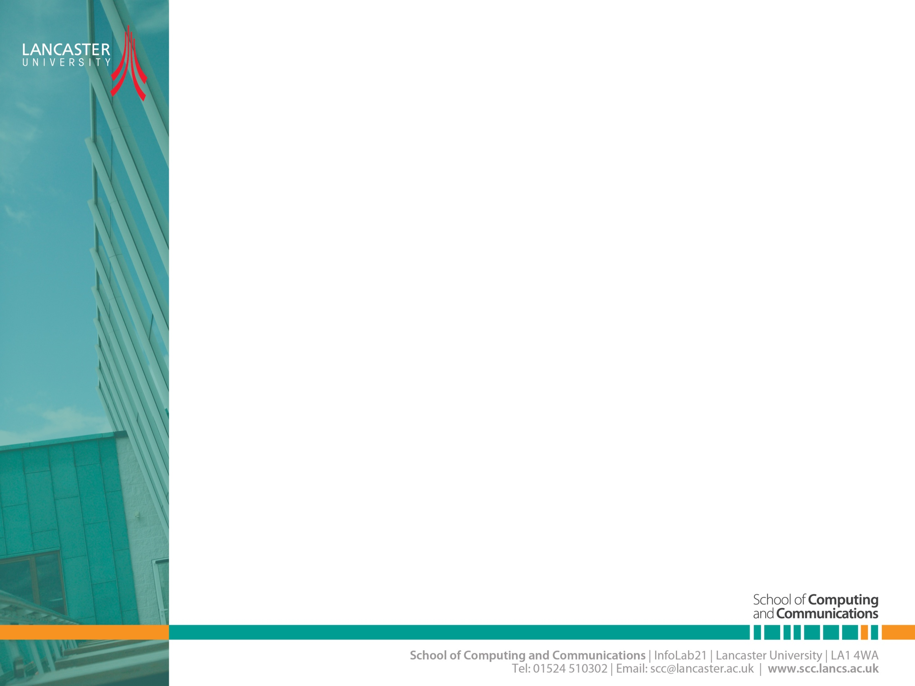

Wireless Channel Modelling
CNSCC.405
Digital Signal Processing
Dr Muhammad Abrar (Dr. MAB)
m.abrar@lancaster.ac.uk

Slide 2
Wireless Channel Modelling
Large-Scale Fading
General Path Loss Model
Small-Scale Fading

Slide 3
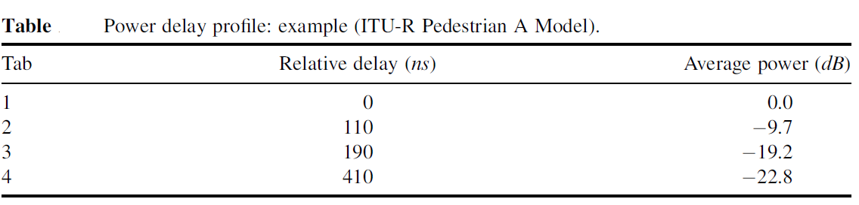
Power Delay Profile (PDP)
Characteristics of a multipath fading channel are often specified by a power delay profile (PDP).
The power delay profile of a channel represents the average power of the received signal in terms of the delay with respect to the first arrival path in multi-path transmission.
Ref: MIMO-OFDM wireless communications with MATLAB. Cho, Y. S., Kim, J., Yang, W. Y., & Kang, C. G. John Wiley & Sons, 2010.
Notes:
Table presents one particular example of PDP specified for the pedestrian channel model by
ITU-R, in which four different multiple signal paths are characterized by their relative delay and average power. Here, the relative delay is an excess delay with respect to the reference time while average power for each path is normalized by that of the first path (tap)

Slide 4
Parameters for Small-Scale Fading
Mean excess delay
RMS delay spread
Both are useful channel parameters that provide a reference of comparison among the different multipath fading channels, and furthermore, show a general guideline to design a wireless transmission system.

Slide 5
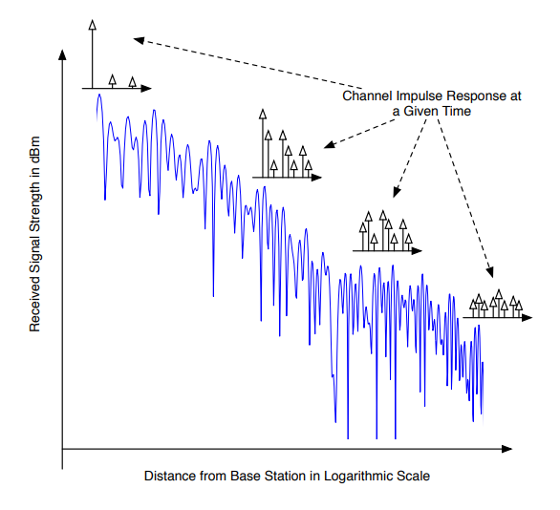
Delay spread over Distance

Slide 6
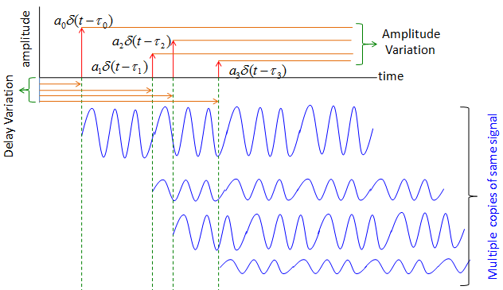
Delay Spread (Time Domain)

Slide 7
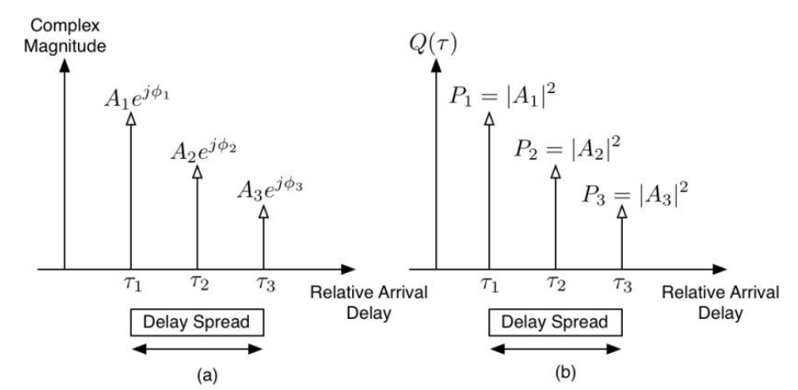
Delay Spread

Slide 8
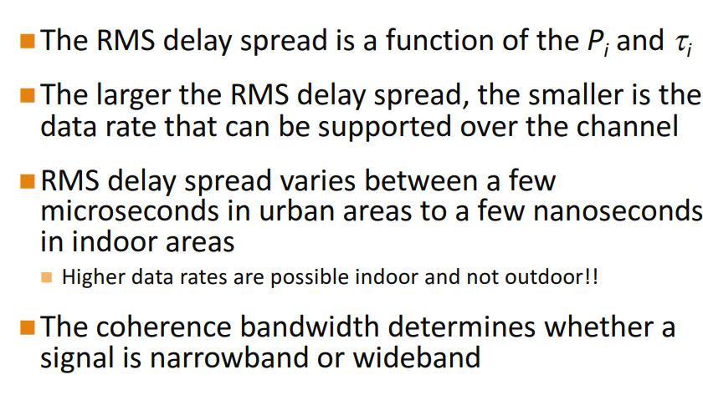
The RMS Delay Spread

Slide 9
Delay Spread (Homework)
ISI problem is dominant in high data rate transmission: Why?
What does standard deviation tell you?

Slide 10
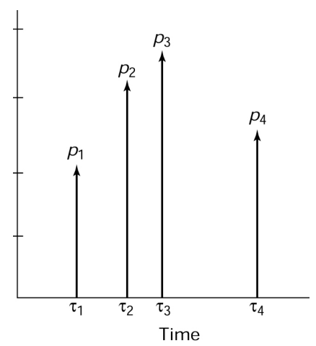
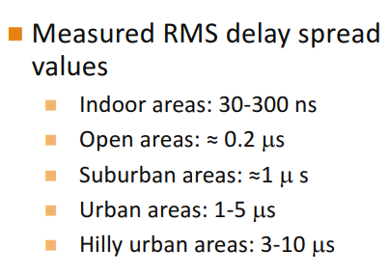
The RMS Delay Spread

Slide 11

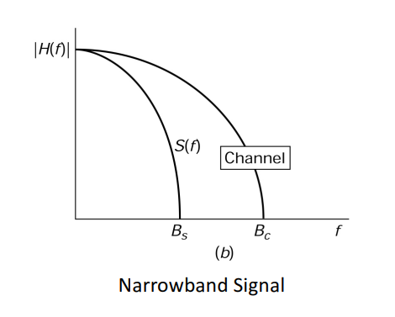
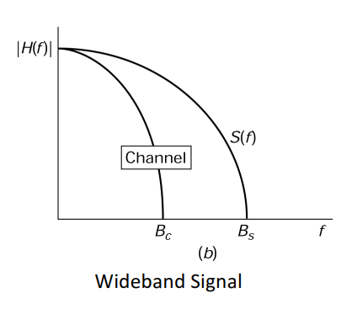
Narrowband & Wideband Signal

Slide 12
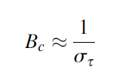


Coherence Bandwidth and RMS Delay Spread
In general, coherence bandwidth, denoted as B_{c}, is inversely-proportional to the RMS delay spread, that is,
In the case where the coherence bandwidth is defined as a bandwidth with correlation of 0.9 or above, coherence bandwidth and RMS delay spread are related as
In the case where the coherence bandwidth is defined as a bandwidth with correlation of 0.5 or above, it is given as

Slide 13
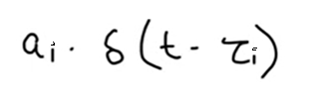
Multipath Propagation Model for Wireless Communication
Each path is characterized by two main factors
For signal, The delay is presented as
Delay
Attenuation

Slide 14
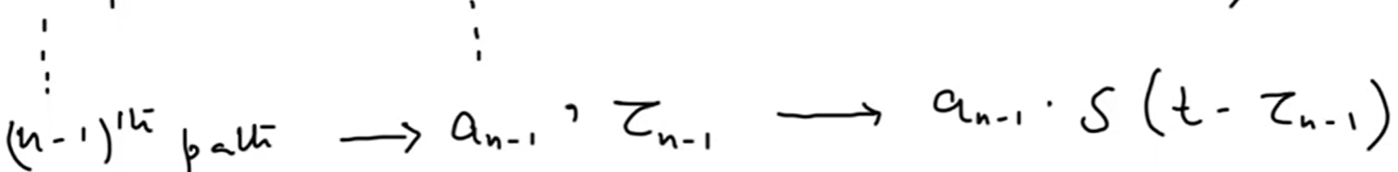
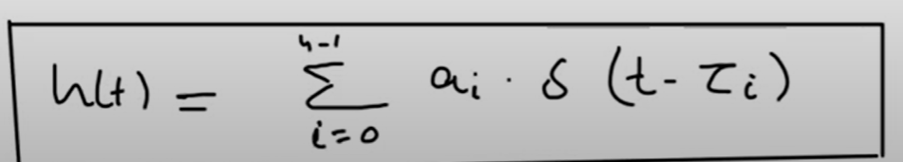
Multipath Propagation
Multipath Channel response = Sum of Individual Responses

Slide 15
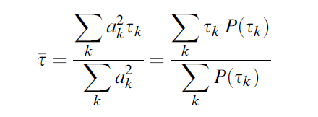

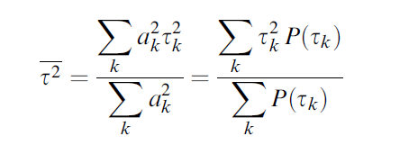
Parameters for Small-Scale Fading
channel delay
power
amplitude
Mean Excess Delay
RMS Delay Spread
where
Notes:
Mean excess delay and RMS delay spread are useful channel parameters that provide a reference of comparison among the different multipath fading channels, and furthermore, show a general guideline to design a wireless transmission system.

Slide 16
Time-Dispersive vs. Frequency-Dispersive Fading
As mobile terminal moves, the specific type of fading for the corresponding receiver depends on both the transmission scheme and channel characteristics.
The transmission scheme is specified with signal parameters such as signal bandwidth and symbol period.
Meanwhile, wireless channels can be characterized by two different channel parameters, multipath delay spread and Doppler spread, each of which causes time dispersion and frequency dispersion, respectively.
Depending on the extent of time dispersion or frequency dispersion, the frequency-selective fading or time-selective fading is induced respectively.

Slide 17
Fading Due to Time Dispersion: Frequency-Selective Fading Channel

Slide 18
Fading Due to Time Dispersion: Frequency-Selective Fading Channel

Slide 19
Fading Due to Frequency Dispersion: Time-Selective Fading Channel
Depending on the extent of the Doppler spread, the received signal undergoes fast or slow fading.
In a fast-fading channel, the coherence time is smaller than the symbol period and thus, a channel impulse response quickly varies within the symbol period.
Variation in the time domain is closely related to movement of the transmitter or receiver, which incurs a spread in the frequency domain, known as a Doppler shift.

Slide 20
Fading Due to Frequency Dispersion: Time-Selective Fading Channel
The transmit signal is subject to fast fading under the following conditions:
T_{s} > T_{c} and B_{s} < B_{d}
bandwidth of Doppler spectrum,
B_{d} = 2f_{m}
transmit signal is subject to slow fading under the following conditions:

Slide 21
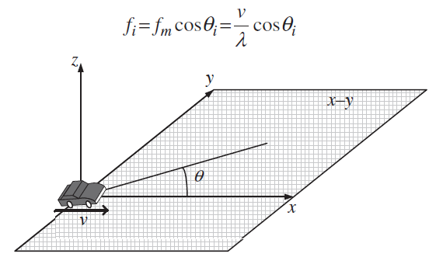

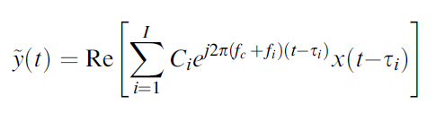



Statistical Characterization of Fading Channel
baseband transmit signal
passband
transmit signal
Clarke’s proposed model
channel gain
delay
Doppler shift
Why we ignore the imaginary part (for analysis)? (Homework)
Notes:
It comes through multiple paths, each with:
a delay $τ_{i}$(because some paths are longer),
a Doppler shift $f_{i}$(because of motion),
and a channel gain $C_{i}$(signal strength depending on reflection or scattering).

Slide 22







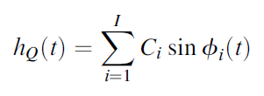

Statistical Characterization of Fading Channel
Baseband Received Signal
Impulse Response:
Dirac delta function
If path delay is much less than the sampling period TS
Assuming that I is large enough
approximated as Gaussian random variables by the central limit theorem.
in-phase
quadrature components
This follows a Rayleigh distribution —

Slide 23
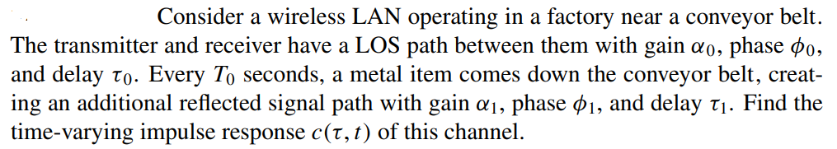
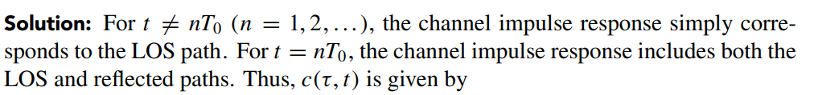

Example

Slide 24
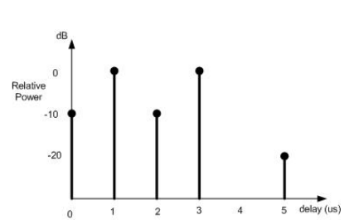
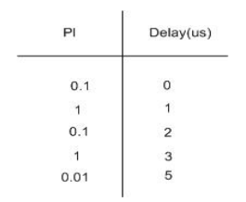
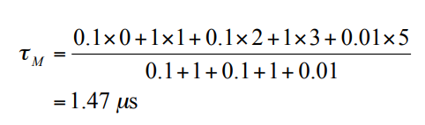
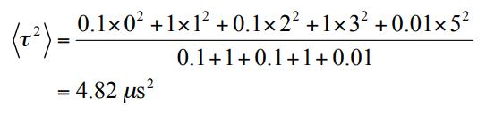


Example-1: rms Delay Spread and Coherence bandwidth=?

Slide 25
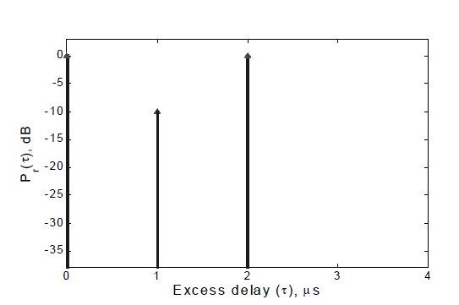
Example-2:
A local spatial average of a power delay profile is shown in Figure
Determine the RMS delay and mean excess delay for the channel
Determine the maximum RF symbol rate if the symbol duration T is less that 1Oσ, where σ is RMS delay spread, an ISI takes place.
If the mobile travelling at 30 Km/hr receives a signal through the channel, determine the time over which the channel appears stationary.

Slide 26






Solution
a
b
C

Slide 27
Example-3
The power delay profile of a typical urban mobile radio channel is given below:
Estimate the 50% coherence bandwidth of the channel.
Will this channel be suitable for AMPS (which has a baseband signal bandwidth B_{S} = 30 kHz) and GSM (which has a baseband signal bandwidth B_{S} = 200 kHz) service without the use of an equaliser?
In a GSM system with the carrier frequency f_{c} = 1.8 GHz, a mobile moves at a speed of v = 120 km/hr. 3. Estimate the Doppler spread of the corresponding channel. 4. Is this channel classified as being slow or fast fading?
Note: AMPS – Advanced mobile phone system; GSM – Global system for mobile communications

Slide 28


Solution:
1
For AMPS, as B_{S} = 30 kHz ≪ B_{C}, the channel is flat, and an equaliser is not required.
2
For GSM: B_{S} = 200 kHz > B_{C}, the channel is frequency selective, and an equaliser would be required.
For single carrier frequency fc = 1.8 GHz, v = 120 km/hr and c = 3 × 108 m/s, the maximum Doppler frequency deviation is
3
Since the signal bandwidth is very small in comparison to the the carrier frequency, the Doppler spread
4
Since B_{S} = 200 kHz ≫ B_{D}, the channel is slow fading.

Slide 29
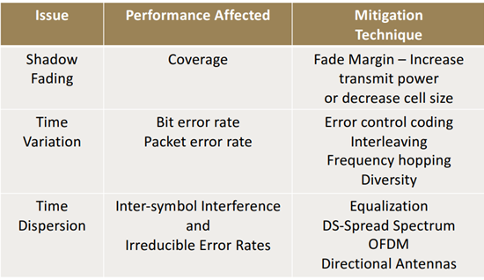
Performance Degradation and Mitigation

Slide 30
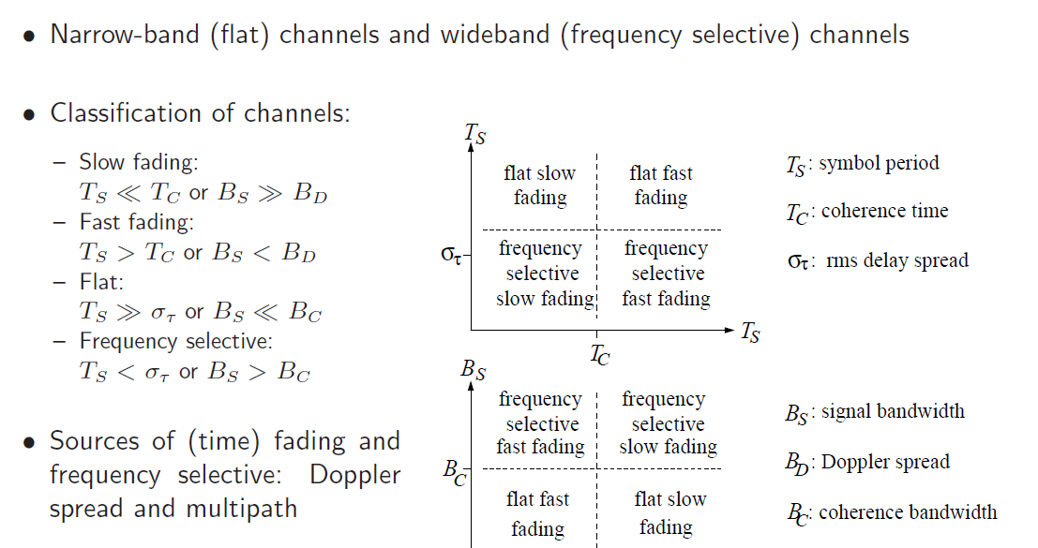
Summary

